Slide 1
National Cybersecurity Awareness Month
2019
OCTOBER
#BeCyberSmart

Slide 2
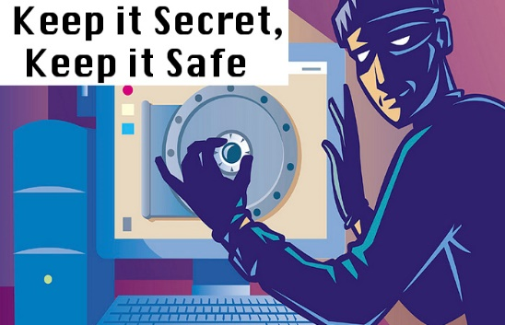
CREATING A PASSWORD
Use a long passphrase (8 or more characters)
Unique account, unique password
Utilize a password manager
Cafeteria fish sticks are awesome!

Slide 3
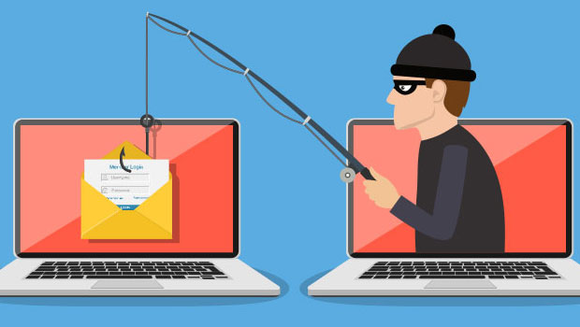
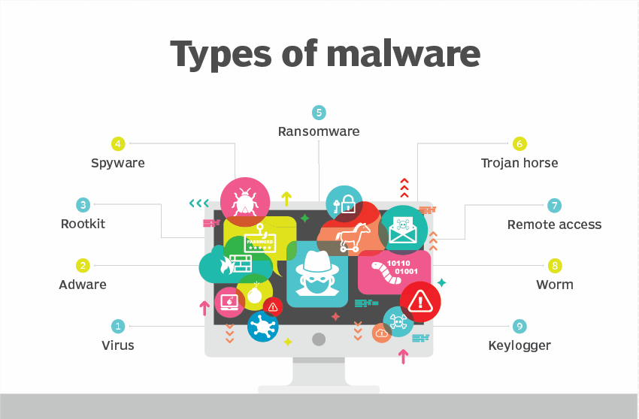
PHISHING
How Criminals lure you in
Email spoofing
Be wary of attachments
Malware
Think before you click

Slide 4
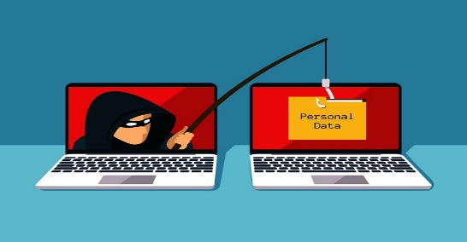
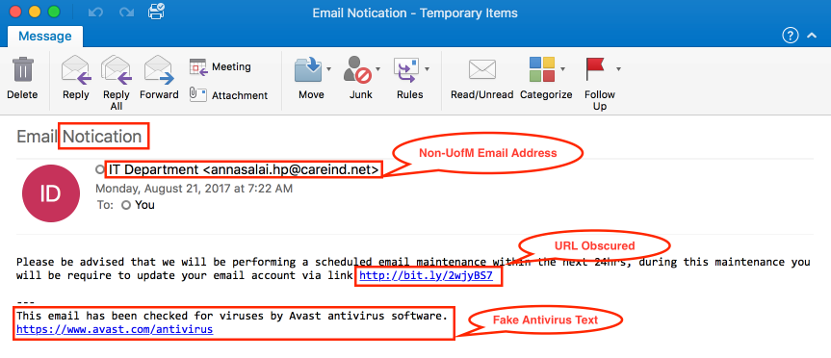

Slide 5
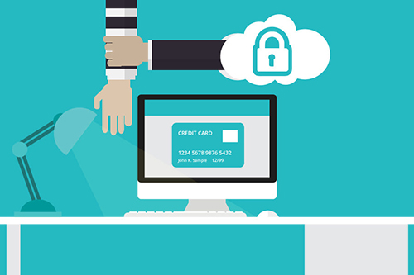
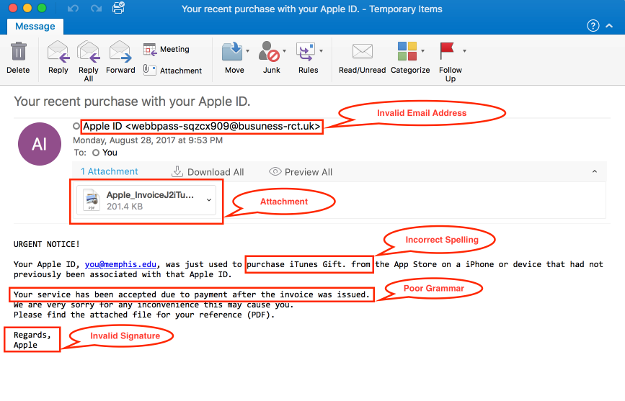

Slide 6
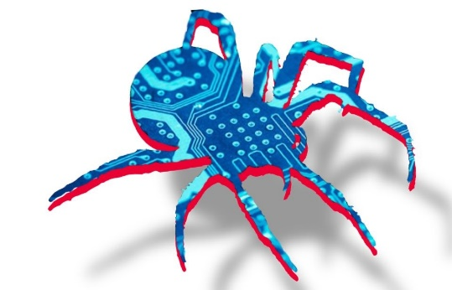
5 WAYS TO BE CYBER SECURE AT WORK
Watch out for Shoulder surfing
Lock your screen
Be up to date
Secure your accounts
Report anything suspicious
Win+L Key

